Slide 1


Does high School education quality correlate to better high school lacrosse teams in 2022?
An exploration into the correlations between education and lacrosse at the high school level
Timothy Yost
Data Analytics 7: Nashville Software School

Slide 2




Data Tools Used
Pulled in data with multiple webscapes.
Manipulated data frames to drill down metrics.
Further manipulated the data for specific metrics to further answer my questions.
Created new columns using formulas
Used for making charts and maps for storytelling
Used for interactive charts

Slide 3

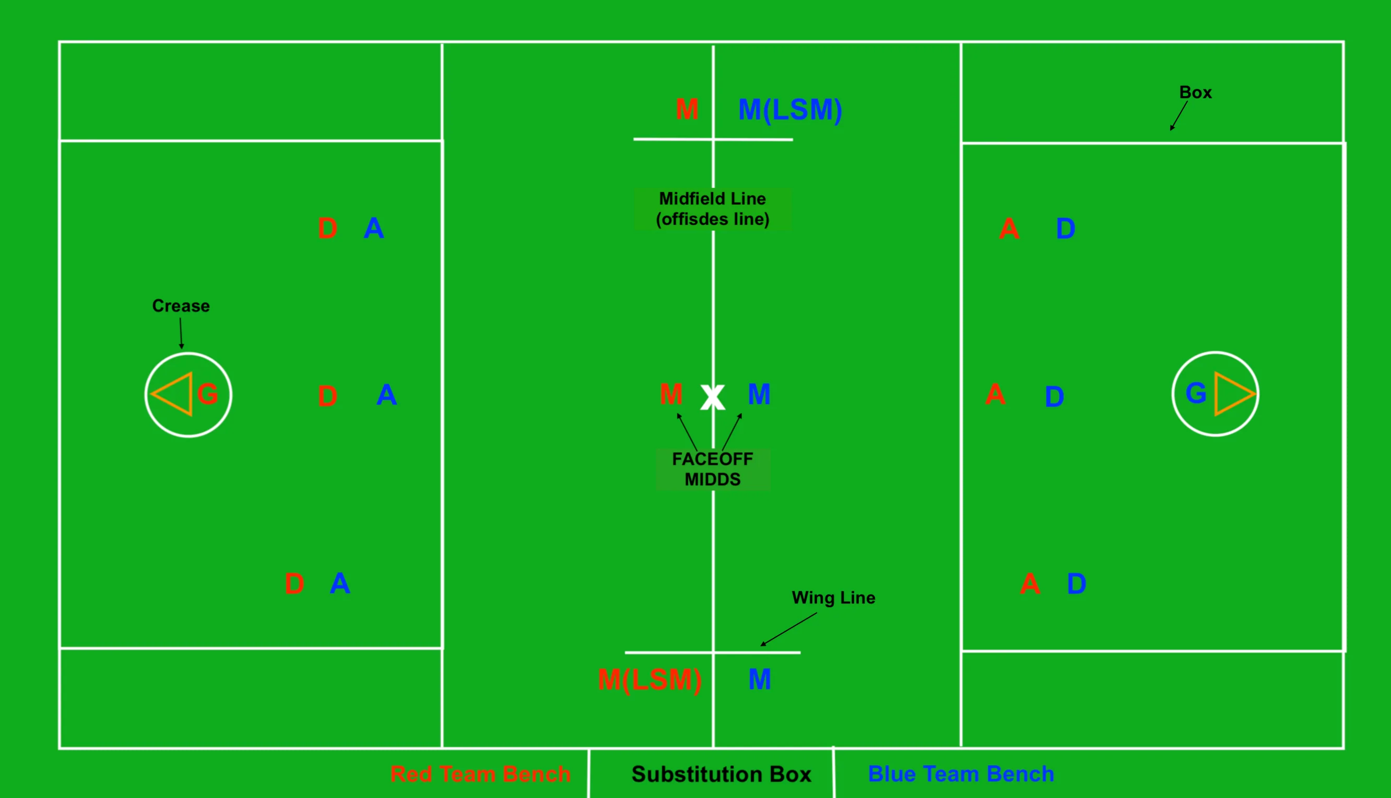
What is Lacrosse?
Lacrosse is the oldest organized sport in North America, with its invention in the 12th century by the Indigenous people of North America.
Field Lacrosse is played on a large field in a 10v10 format with the object being to put the ball in the opposing net. With 4 12-minute quarters. Men’s lacrosse is a contact sport with similar rules to ice hockey.
Here we will be focusing on boy’s High school field lacrosse as it correlates High School education ranking in 2022.

Slide 4
What makes a a school better? Safety and Quality!
Safety is calculated
Existence of Digital Learning Plan
State Statute on Out of School access to instructional materials
State Guidance on Accessible Technologies
Share of Threatened/Injured High school Students
Share of High School Students not attending School due to Safety concerns
Share of Children whose parents agree their children go to safe schools
Share of High School Students Participating in Violence
Share of Armed High School Students
Number of School Shootings
School Safety Plan Requirements
Presence of Adopted and Enacted Laws
Youth Incarceration Rate
School Safet Aduit Requirment
Quality is calculated
Presense of Public Schools in the “Top 700 Best U.S. School”
Blue Ribbon Schools Per Capita
High School Graduation Rate Among Low-Income Students
Projected High School Graduation Rate Increase between 2021-2022 and 2022-2033 School Year.
Dropout Rate
Math Test Scores
Reading Test Scores
Median SAT and ACT scores
Pupil-Teacher Rario
Shared Licensed/Cerified Public K-12 Teachers

Slide 5
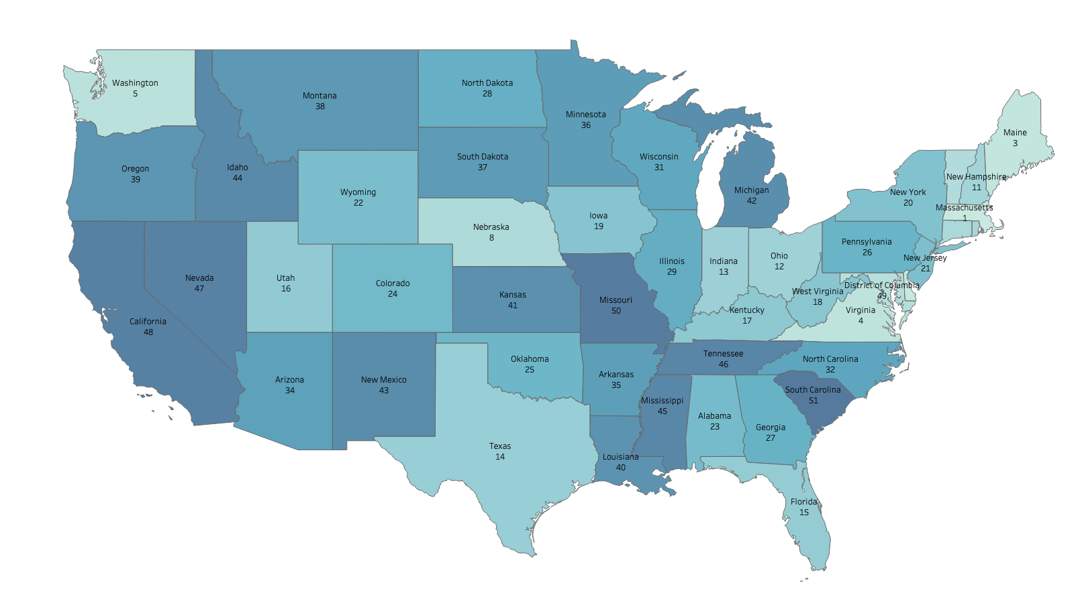
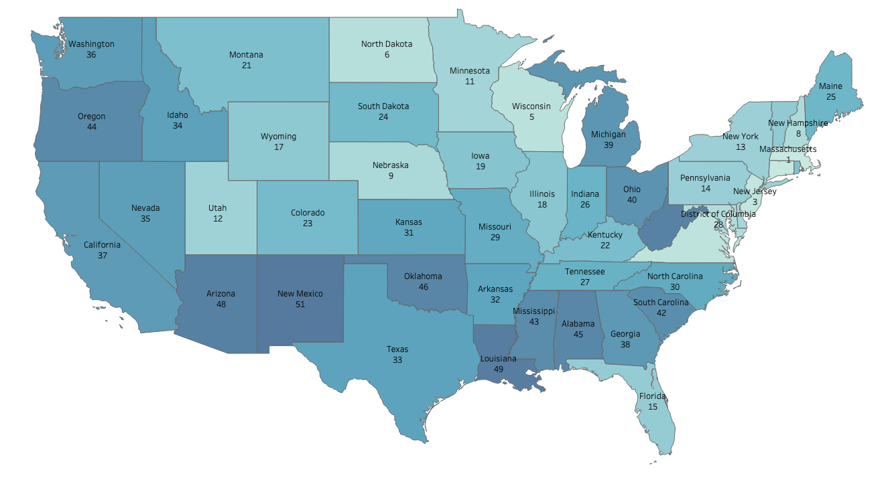
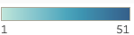
States Ranked by Safety
States Ranked by Quality
The Northeast seems to dominate both overall metrics.
Population does not seem to be a major factored when looking at states instead of school district or individual schools.
The upper middle of north America does surprising well in Quality even if their safety seems to be lacking.
The South seems to be in the middle of both metrics.

Slide 6
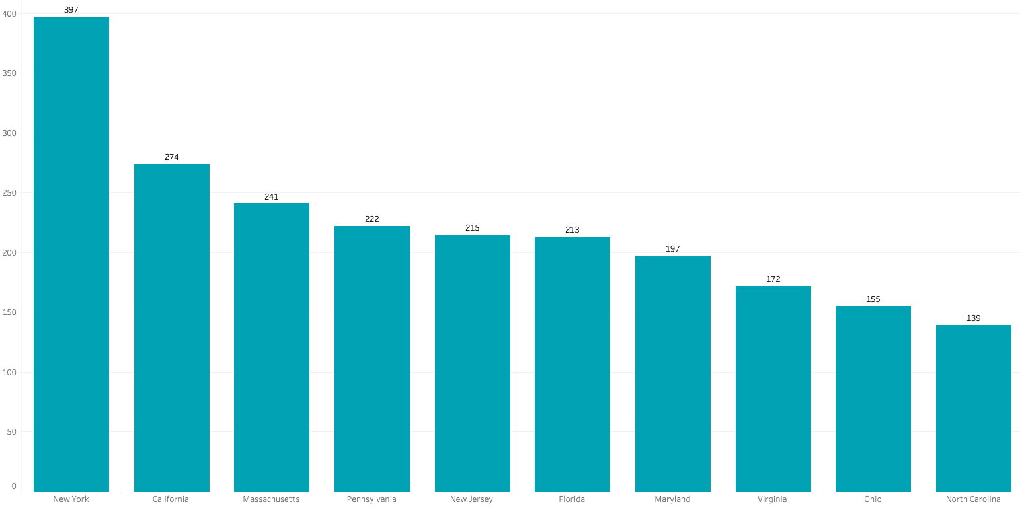
Which States have the highest amount of high school men’s teams?
This chart shows the top 10 states with the most boys high school lacrosse teams in 2022.

Slide 7
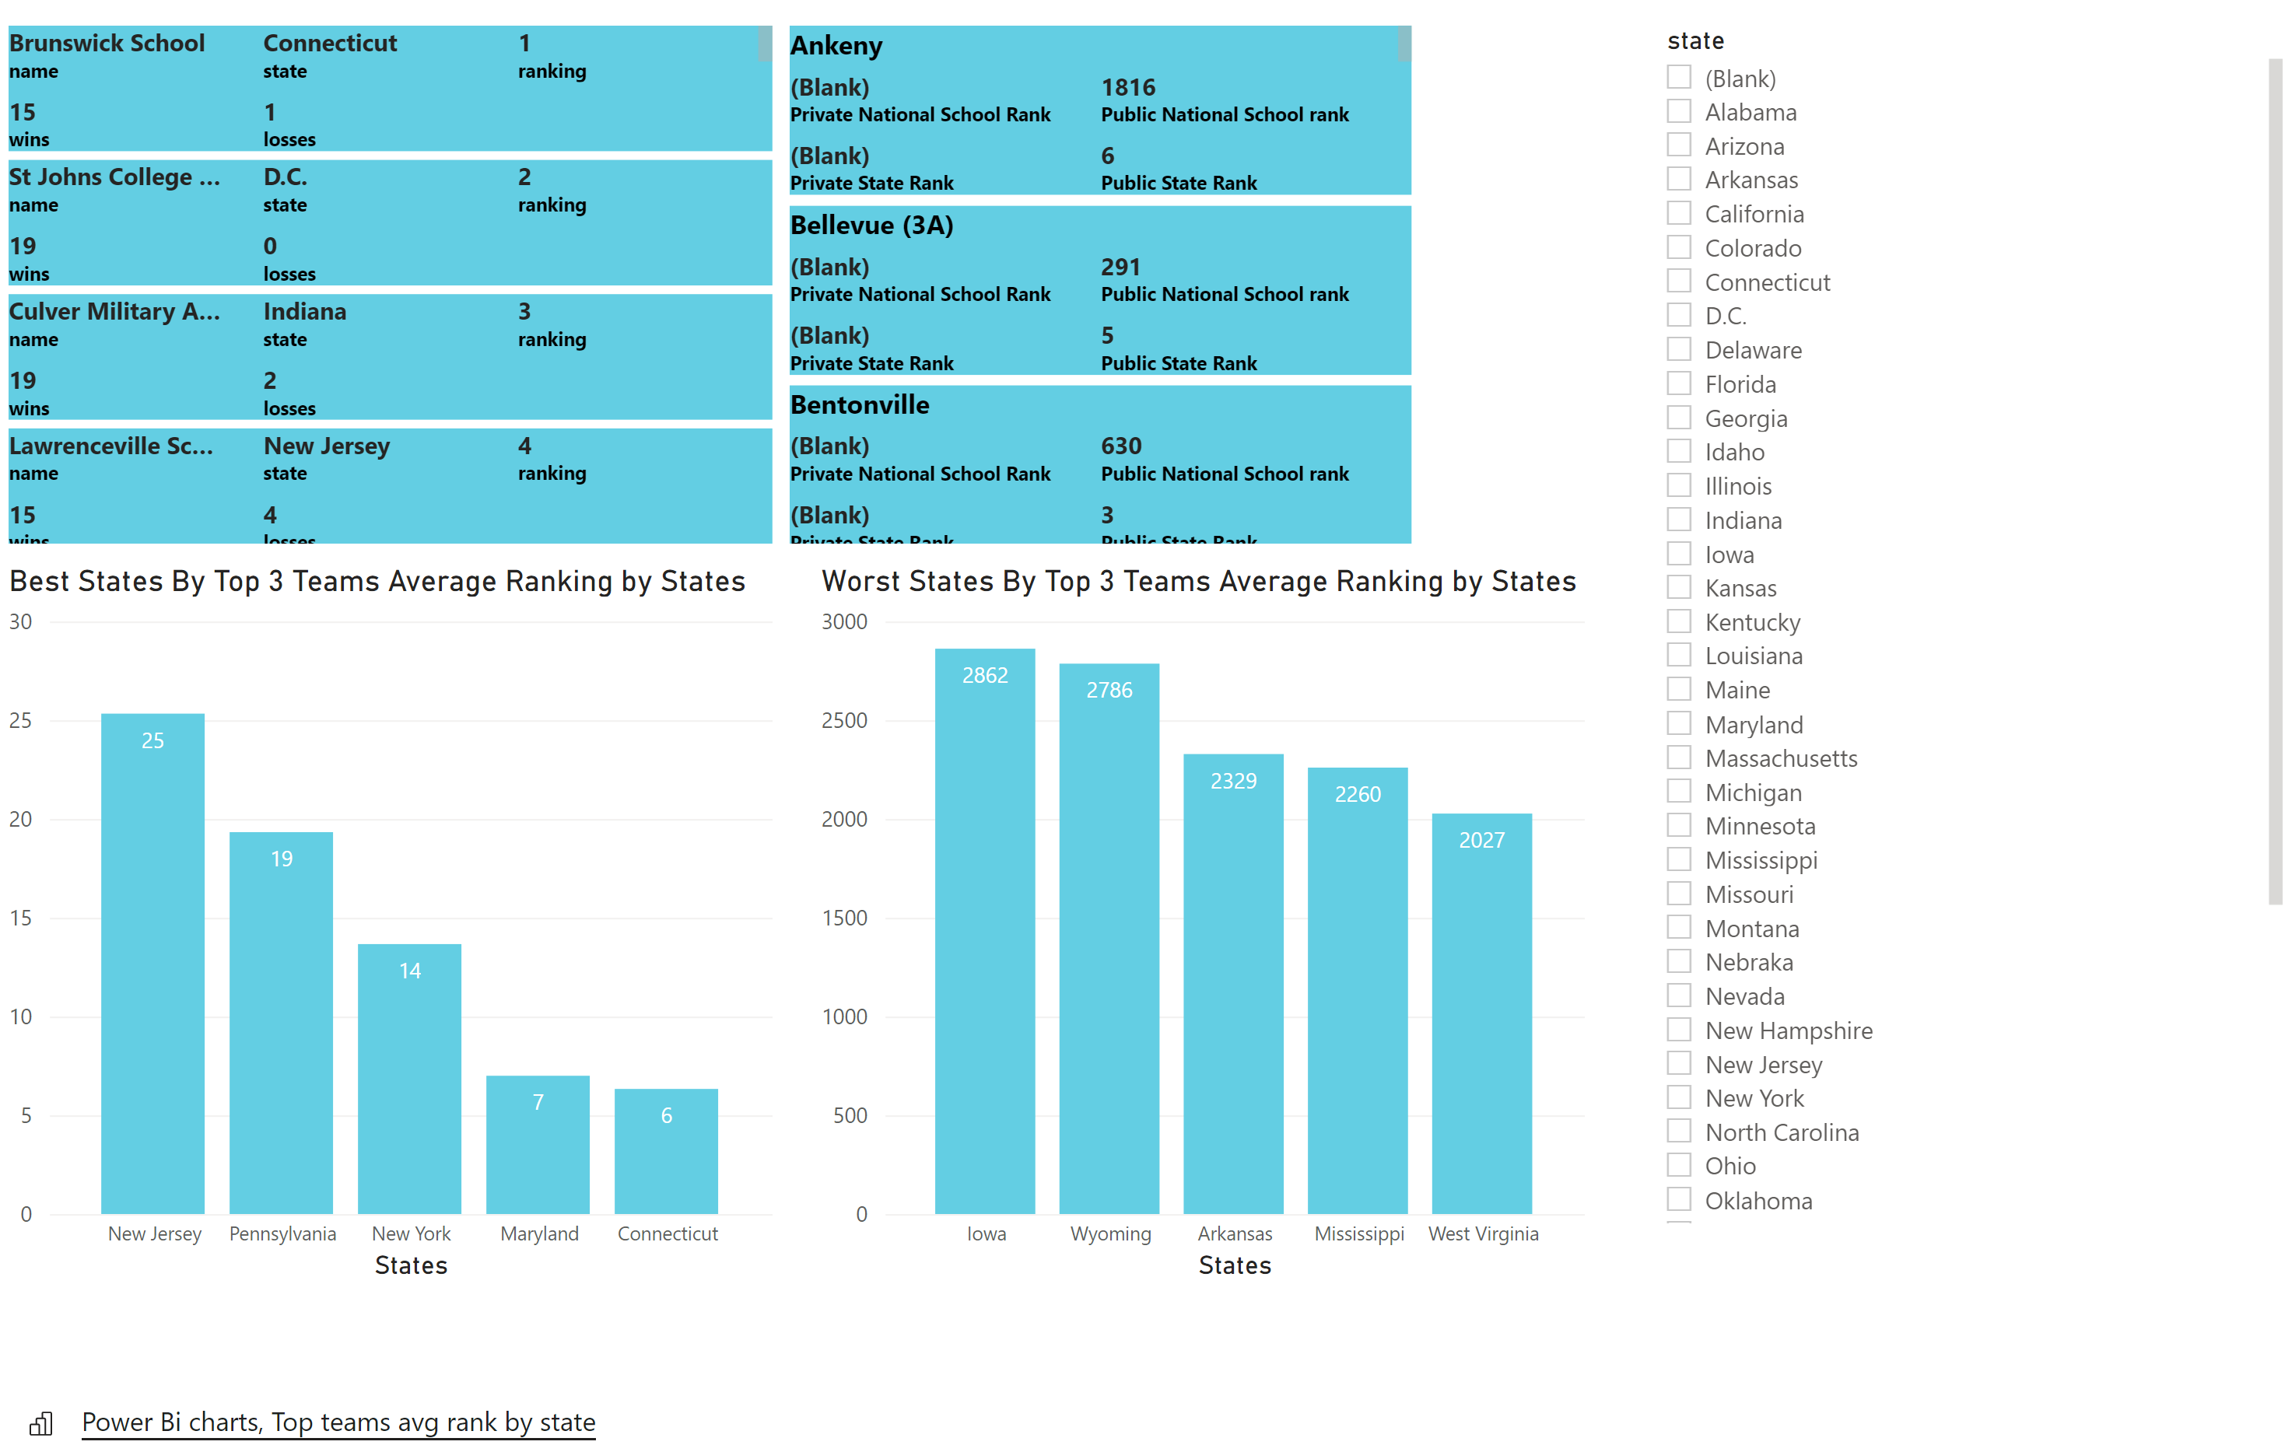
Lacrosse record
School Ranks
Here we have a break down of the top 3 teams from the top 5 states.
Similar correlation between the states with the most teams and quality of team.
We also take a look at the bottom 5 states and their top 3 teams.
The bottom 5 states tend to have less lacrosse teams overall.

Slide 8
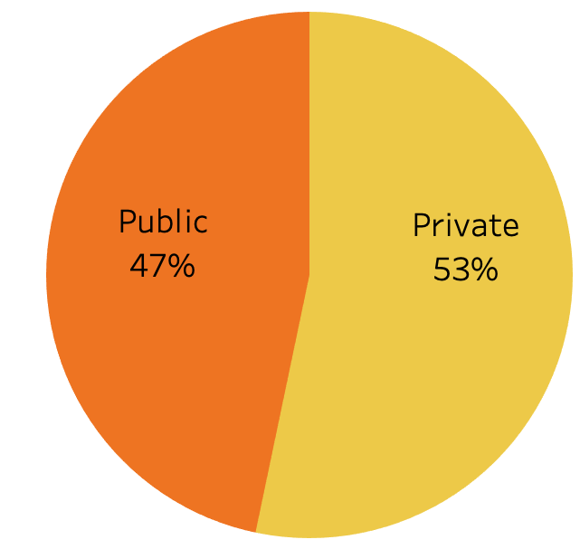
Taking the top 3 lacrosse teams from each state this is the percent of public vs Private school

Slide 9
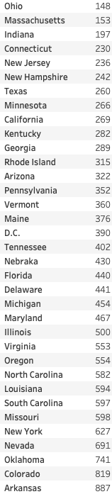
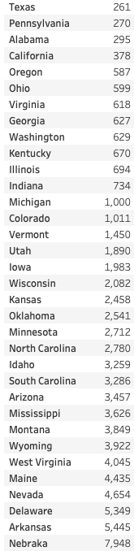
Private Public
Using the top 3 lacrosse teams from each state I then averaged their educational ranks.
I also divided them by private and public school.
Its important to remember that there are less private schools in each state so their national ranking may appear to be better those compared to Public

Slide 10
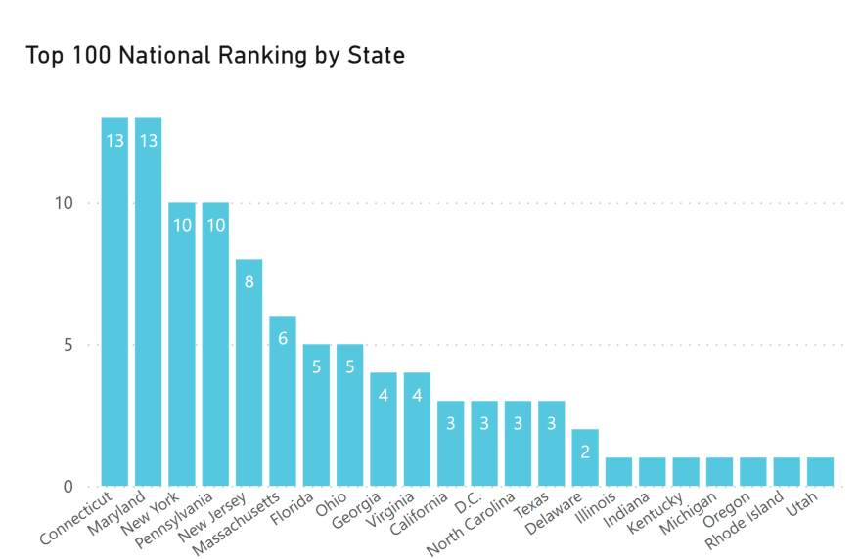
Here is the state representation of states in the top 100 nationally ranked teams in 2022
The states in the northeast continue to dominate
States in the Midwest make up a small amount of those teams

Slide 11
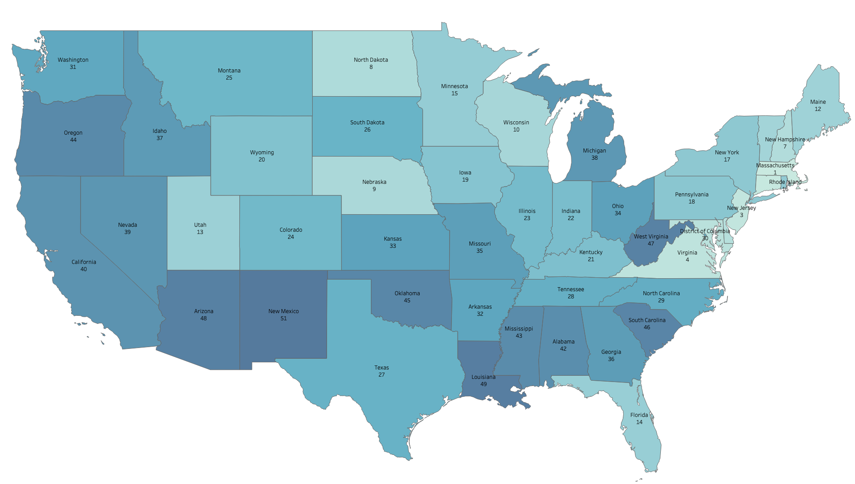
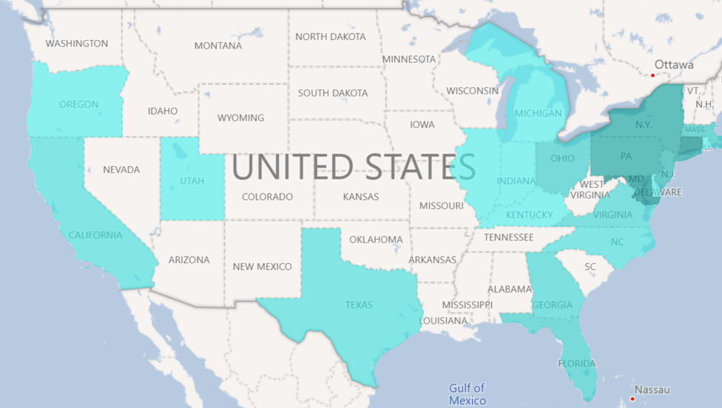
Overall State Education Ranking
At the top we have overall state education ranking and on the bottom we have the states with the most team in the top 100.
As we can see the upper northeast dominates in the lacrosse ranks and also seems to be the case when it comes to overall Education ranks as well.
As a conclusion I would say that overall education quality does impact a lacrosse team’s performance.
States with the most 100 ranked lacrosse teams

Slide 12
Sources
https://www.niche.com/k12/search/best-all-boys-high-schools/
https://nces.ed.gov/programs/coe
https://en.wikipedia.org/wiki/Lacrosse#Lacrosse_in_the_United_States
https://wallethub.com/edu/e/states-with-the-best-schools/5335
https://www.usnews.com/education/best-high-schools/articles/how-states-compare
https://www.laxnumbers.com/ratings.php?y=2022&v=3000

Slide 13
Questions?

